Slide 1
Cornell Notes
Quick Review

Slide 2
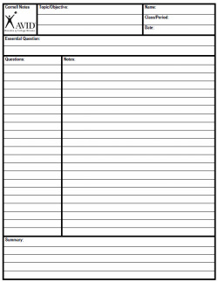

Slide 3
Cornell Notes Format
Top right hand corner: Name, class period, date
Title: Topic or objective
Below title: Essential question
Left side: Questions
Your questions should correlate with the information that is written in your notes
Great quiz tool
Right side: Notes
Leave space in between topics
Chunk together information into separate groups
Underline and circle important words or concepts
Bottom: Summary
Summarize the notes you have taken
Your summary should be able to answer the essential question (in most cases)

Slide 4
Intro to Conflict and Plot

Slide 5
Essential Question
How can conflict fuel a story?
What are the elements of plot development?

Slide 6
Objectives
I will analyze the various forms of conflict, and be able to identify the elements of linear plot development.

Slide 7
Conflict
What are all good stories fueled by?
What is conflict?
Conflict is a struggle between opposing forces.

Slide 8
Conflict
External conflict: a struggle between a character and an outside force
Internal conflict: a struggle that takes place within a character’s own mind

Slide 9
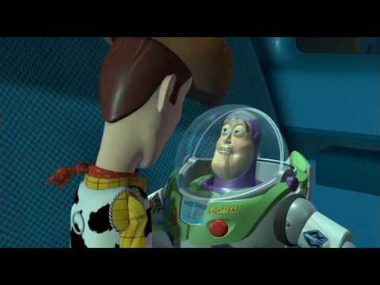
Conflict
Is this an example of external or internal conflict?

Slide 10
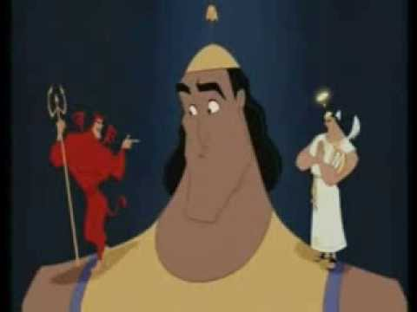
Conflict
Is this is an example of internal or external conflict?

Slide 11
Types of Conflict
External
Character v. Character
Character v. Force of Nature
Character v. Society
Internal
Character v. Self
Which types of conflicts were Buzz, Woody and Kronk facing?

Slide 12
Stages of Plot
Plot: the series of events in a story
In a linear plot, the order in which these stages occur follows a pattern.

Slide 13
Stages/Elements of Plot
Exposition
Rising Action
Climax
Falling Action
Resolution

Slide 14
Stages of Plot
Exposition:
Introduces setting and characters
Reveals or sets the stage for the conflict

Slide 15
Stages of Plot
Rising Action:
Introduces obstacles that make the conflict more complicated
Builds suspense

Slide 16
Stages of Plot
Climax:
Turning point in the story
Moment of greatest suspense
Presents conflict at its most intense and dramatic

Slide 17
Stages of Plot
Falling Action:
Reveals the outcome of the story’s climax
Eases tension
Shows how main character resolves the conflict

Slide 18
Stages of Plot
Resolution:
Reveals story’s final outcome
Ties up any loose ends

Slide 19
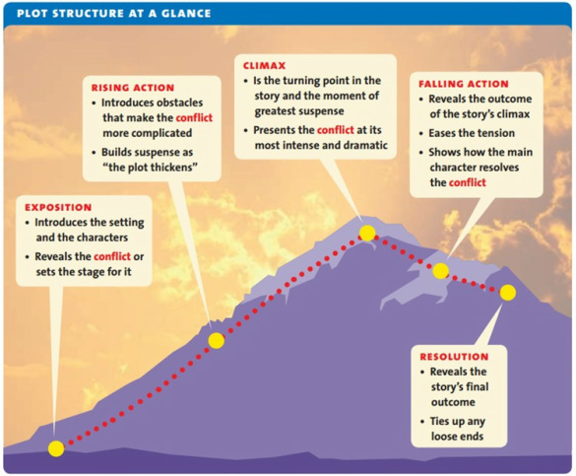

Slide 20
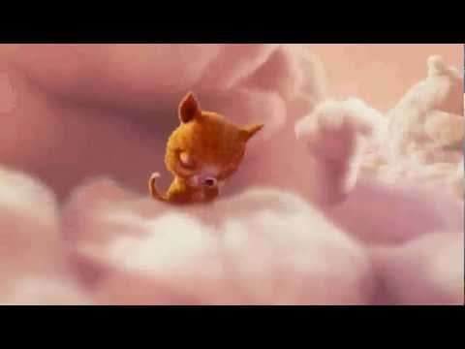

Slide 21
Sources
Allen, Janet. Holt McDougal Literature: Texas Grade 8. Evanston, IL: Holt McDougal, a Division of
Houghton Mifflin Harcourt, 2010. Print.

